Slide 1
E-Commerce Website
Muhammad Subhan Naeem Qureshi 48802
Abdul haseeb 46997

Slide 2
Abstract
If your customers wish to see your business online and have instant access to your products or services.
Online Shopping is a lifestyle e-commerce web application, which retails various fashion and lifestyle products (Currently Men's Wear).
This is a project with the objective to develop a basic website where a consumer is provided with a shopping cart application and also to know about the technologies used to develop such an application.
This document will discuss each of the underlying technologies to create and implement an eCommerce website.

Slide 3
Introduction
It is reasonable to say that the process of shopping on the web is becoming commonplace.
The objective of this project is to develop a general purpose e-commerce store where product like clothes can be bought from the comfort of home through the Internet.
However, for implementation purposes, this paper will deal with an online shopping for clothes.
An online store is a virtual store on the Internet where customers can browse the catalog and select products of interest.

Slide 4
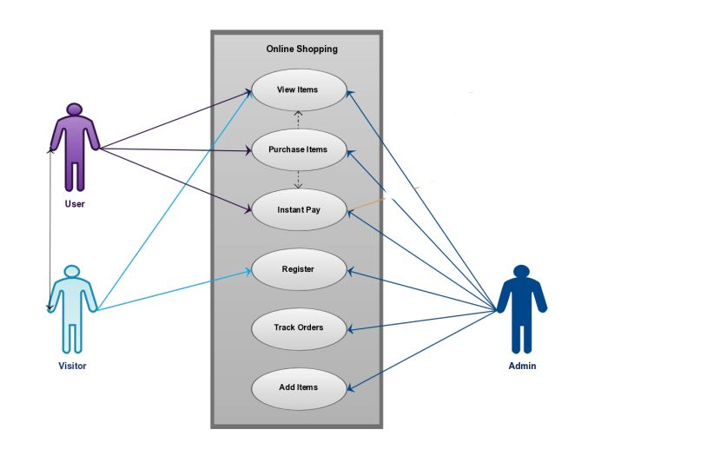
Use Case

Slide 5
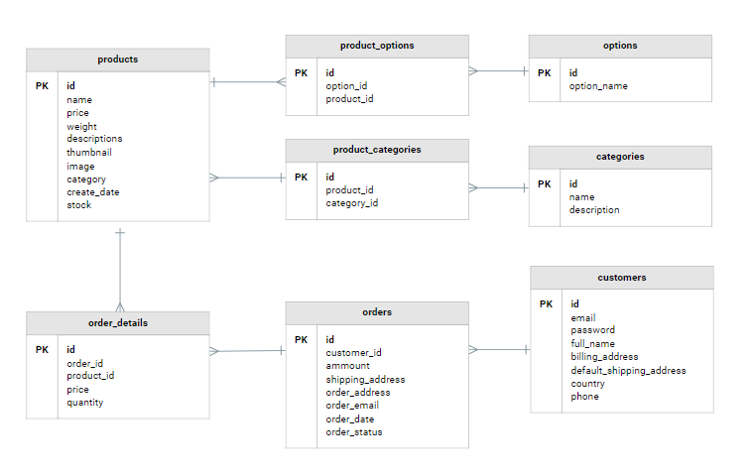
ERD

Slide 6
Functional Requirements
Speed
Mobile-Friendliness
Product Attributes
Order & Checkout Flow
Accessibility

Slide 7
Non Functional Requirements
Usability
Security
Performance

Slide 8
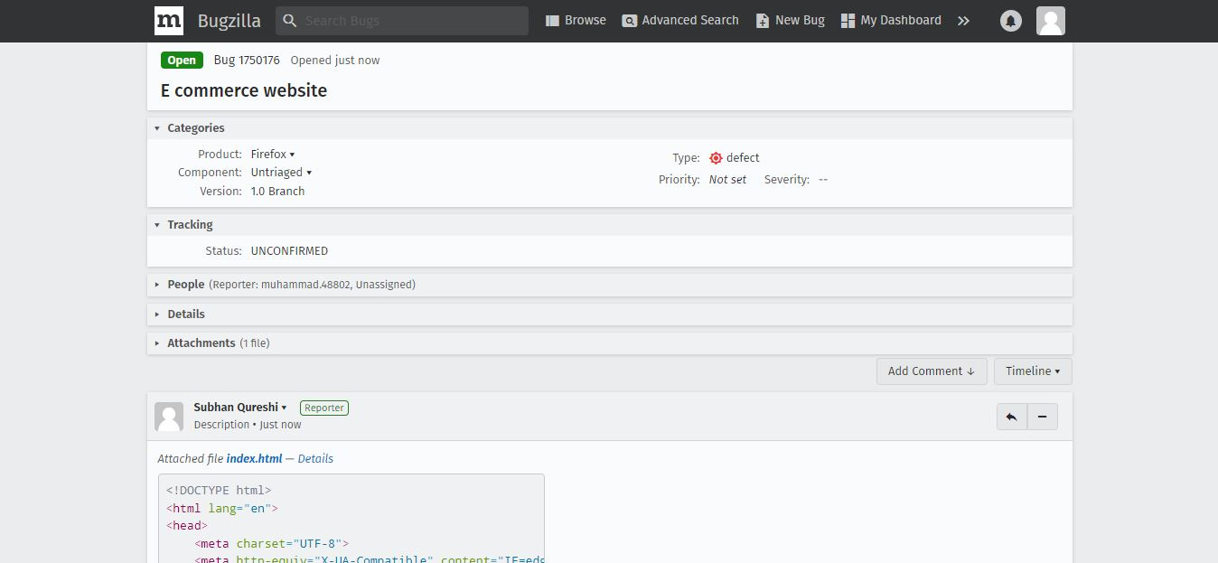
Bug Tracking

Slide 9
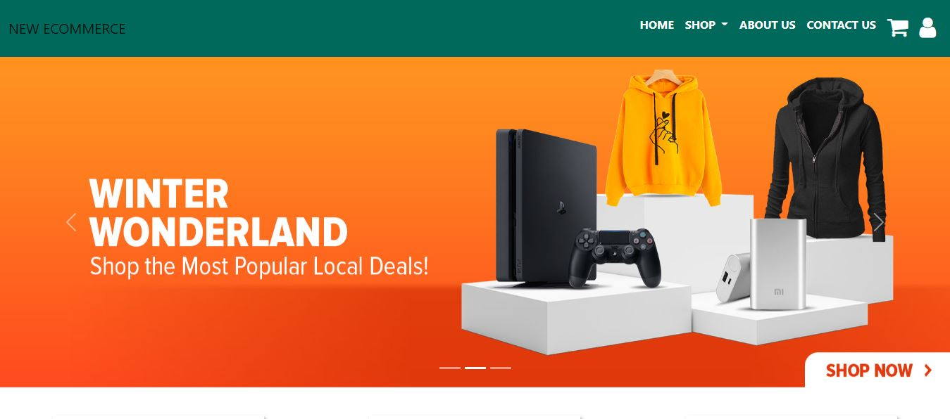
Output

Slide 10
Version Controlling
Github Link: https://github.com/qureshi23/softwareConstruction
Thank You

